Slide 1

KIT-KALAIGNARKARUNANIDHI INSTITUTE OF TECHNOLOGY
COIMBATORE-641402
DEVELOPMENT OF MOBILE APP FOR PREDICTING OVARIAN CANCER BY USING AI
Presented By:
HARSHINI R
PRASANA R
DHARSHINI R
Under the Guidance of:
Dr. A. S. Arunprasad Assistant professor
Department of Biotechnology.

Slide 2
TABLE OF CONTENTS
Introduction
Problem statement
Objectives
Review of literature
Methodology
5.1 Dataset description
5.2 Project parameters
6. Result
7. Future work
8. Reference

Slide 3
1.INTRODUTION
Ovarian cancer found to be one of most dangerous Gynaecological malignancies .
Over 207,000 women die annually by Ovarian cancer.
It is more difficult to manually analyse, because it has many subtypes(HGSC, LGSC, etc) & also have high demand for Gynaecologic oncologist.
AI can improve accuracy and reduce diagnosis time & cost.

Slide 4
2.PROBLEM STATEMENT
Late-stage detection increases mortality rate.
Need for automated, fast, and reliable screening.
Reduce dependency on manual microscopic examination.

Slide 5
3.OBJECTIVES
To develop an ML-based system for the early prediction of ovarian cancer using clinical and biomarker data.
To improve the accuracy and reliability of ovarian cancer detection using machine learning techniques.
To assist in early diagnosis and support timely treatment through a user-friendly mobile application.

Slide 6
4. REVIEW OF LITERATURE
Journal Name | Author(s) | Article Title | Remarks
The Lancet Digital Health (2024) | Cai, G., Huang, F., Gao, Y., Li, X., Chi, J., Xie, J., Zhou, L., Feng, Y., Huang, H., Deng, T., Zhou, Y., Zhang, C., Luo, X., Xie, X., Gao, Q., Zhen, X., & Liu, J. | Artificial intelligence–based models enabling accurate diagnosis of ovarian cancer using laboratory tests in China: A multicentre, retrospective cohort study | Multicentre study showing AI models can accurately diagnose ovarian cancer from lab tests; highlights potential for clinical adoption in China.
Health Science Reports (2024) | Ayyoubzadeh, S. M., Ahmadi, M., Yazdipour, A. B., Ghorbani-Bidkorpeh, F., & Ahmadi, M. | Prediction of ovarian cancer using artificial intelligence tools | Demonstrates predictive capability of AI tools for ovarian cancer; emphasizes feasibility of AI in early detection.
Diagnostics (2025) | Hong, M.-K., & Ding, D.-C. | Early diagnosis of ovarian cancer: A comprehensive review of the advances, challenges, and future directions | Review article summarizing advances in early diagnosis, current challenges, and future directions in ovarian cancer detection.

Slide 7
Journal Name | Author Name | Article Title | Remarks
eClinicalMedicine (2022) | Xu, H.-L., Gong, T.-T., Liu, F.-H., Chen, H.-Y., Xiao, Q., Hou, Y., Huang, Y., Sun, H.-Z., Shi, Y., Gao, S., Lou, Y., Chang, Q., Zhao, Y.-H., Gao, Q.-L., & Wu, Q.-J. | Artificial intelligence performance in image-based ovarian cancer identification: A systematic review and meta-analysis | Meta-analysis evaluating AI performance in image-based ovarian cancer identification; confirms strong diagnostic accuracy across studies.
Oncology Reports (2024) | Wang, Y., Lin, W., Zhuang, X., Wang, X., He, Y., Li, L., & Lyu, G. | Advances in artificial intelligence for the diagnosis and treatment of ovarian cancer | Overview of AI applications in both diagnosis and treatment; highlights progress and clinical integration potential.
Anticancer Research (2020) | Akazawa, M., & Hashimoto, K | Artificial Intelligence in Ovarian Cancer Diagnosis | Single-center study using 5 machine learning algorithms (XGBoost, Random Forest, SVM, Logistic Regression, Naive Bayes); achieved highest accuracy of 0.80 with XGBoost; emphasizes need for larger datasets and integration of imaging data.

Slide 8
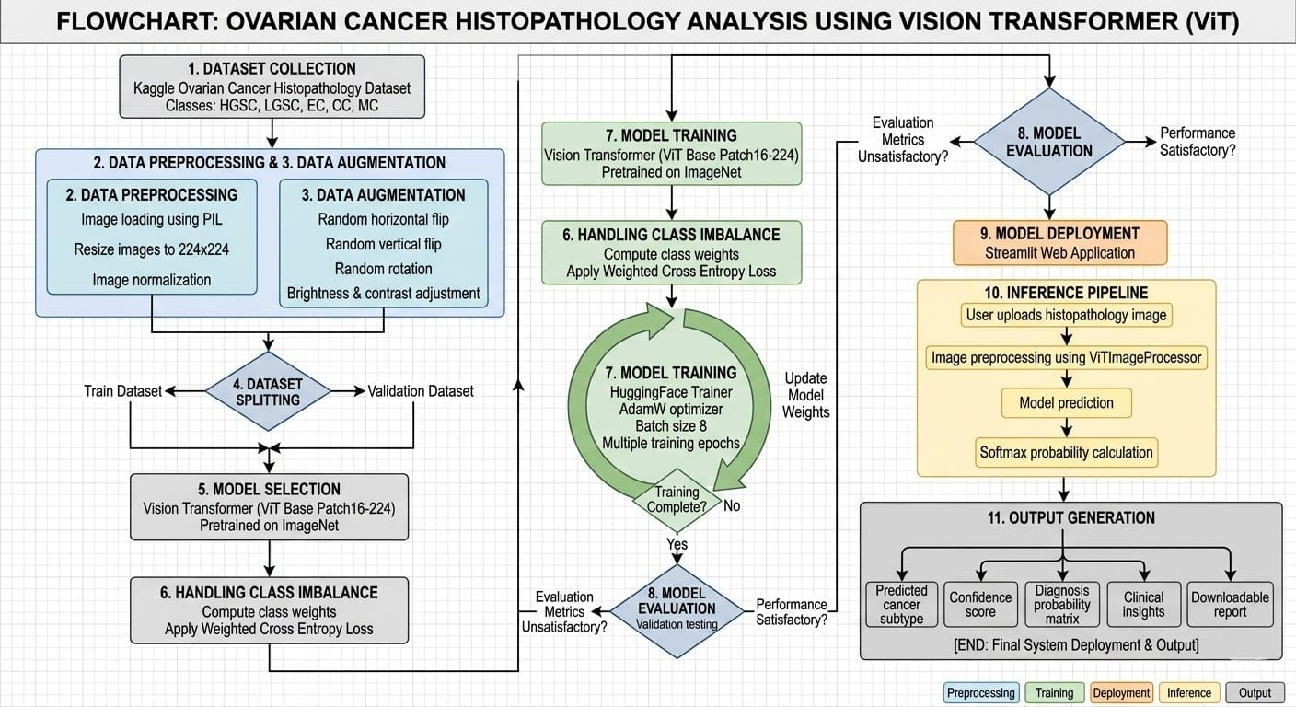
5 .METHODOLOGY

Slide 9
5.1 DATASET DESCRIPTION
Total of 33,000 histopathology images were taken.
Publicly available datasets on Kaggle website.
Stratified split: 80% Training, 20% Testing.
That is 26400 images have been trained and 6600 images have been used for testing.

Slide 10
Dataset: Kaggle UBC-OCEAN (34,000+ histological images)
5.2 PROJECT parameters
Dataset: Kaggle UBC-OCEAN (33,000 histological images)
Preprocessing: Resize 224×224, normalization (ImageNet-21k), label cleanup
Model: Vision Transformer (ViT-base-patch16-224-in21k)
Training: Hugging Face Trainer, weighted cross-entropy loss, AdamW optimizer (lr=3e-5)
Classes: HGSC, LGSC, EC, CC, MC
Backend: FastAPI + PyTorch inference pipeline
Clinical Logic: ROMA algorithm (CA-125, HE4, age)
UI/UX: Streamlit web portal
Outputs: Confidence scores, morphological insights, exportable clinical reports

Slide 11

The AI-based system analyzed histopathological ovarian tissue images to detect patterns associated with ovarian cancer.
The model was able to identify and classify different types of ovarian cancer, including High-Grade Serous, Low-Grade Serous, Endometrioid, Clear Cell, and Mucinous carcinoma.
The diagnostic matrix generated probability scores for each cancer type, which can support early detection and clinical decision-making.

Slide 12
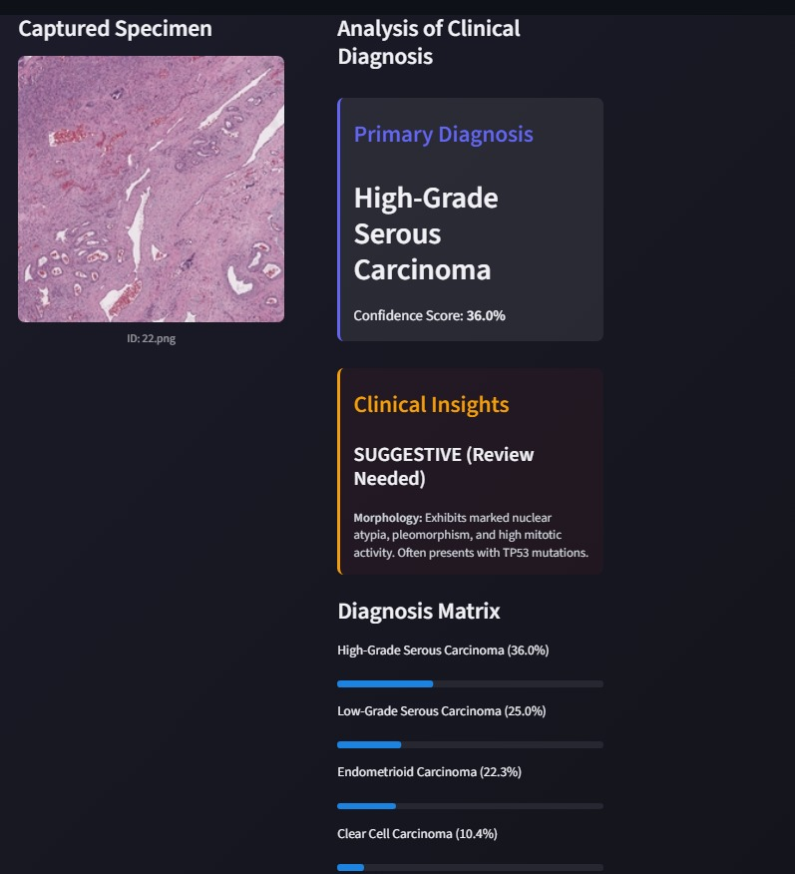
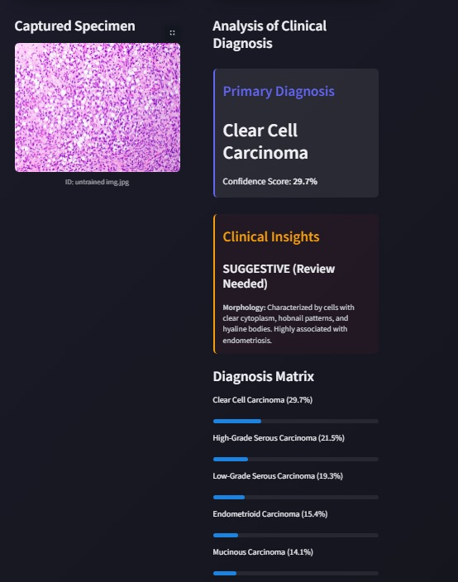
Fig .1:Trained data output
Fig .2:Untrained data output

Slide 13
7.FUTURE WORK
Develop a cross-platform mobile application using Flutter with secure user authentication and image upload (camera/gallery) functionality.
Integrate clinical parameters (CA-125, HE4, Age) and connect the app to a backend system for real-time AI-based ovarian cancer prediction.

Slide 14
8.REFERENCE
Cai G. (2024). Artificial intelligence-based models enabling accurate diagnosis of ovarian cancer using laboratory tests in China. Health Science Reports, 7(7), 2203.
Ayoubi Zadeh S.M. (2024). Prediction of ovarian cancer using artificial intelligence tools. Health Science Reports, 7, 2203.
Hong M.K., Ding D.C. (2025). Early diagnosis of ovarian cancer: A comprehensive review of the advances, challenges, and future directions. Diagnostics, 15(4), 406.
Xu H.L. (2022). Artificial intelligence performance in image-based ovarian cancer identification: A systematic review and meta-analysis. eClinicalMedicine, 53, 101662.
Wang Y. (2024). Advances in artificial intelligence for the diagnosis and treatment of ovarian cancer. Oncology Reports, 51, 46.
Akazawa M., Hashimoto K. (2020). Artificial intelligence in ovarian cancer diagnosis. Anticancer Research, 40(9), 4795–4800.14482

Slide 15
THANK YOU

